Slide 1


Visionary Course - Energy AI
Week 12
Nov 14, 2022
Sohee Kim, Giwon Sur

Slide 2


https://view.kentech.ac.kr
Week 12a – Inference for road following on Jetson Nano
Notes:
Today, we will do about inference for road following on Jetson Nano

Slide 3
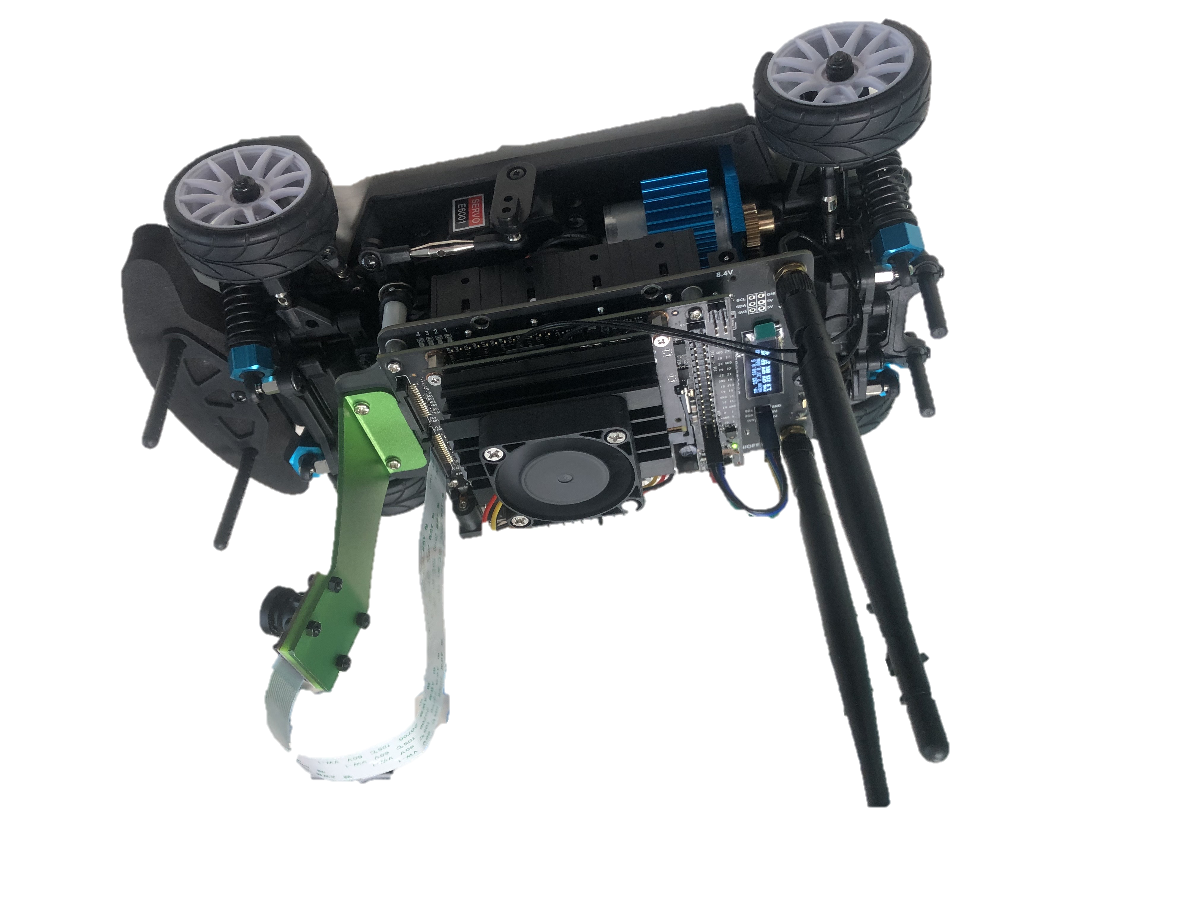
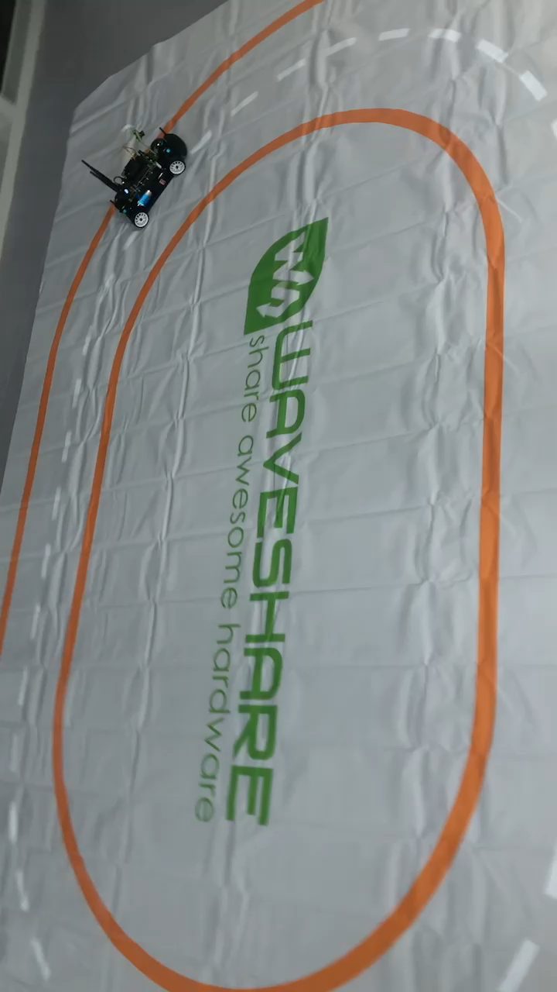
JetRacer: Let's start autonomous driving!
Today we will test the pretrained model on the road with 2D-lined track.
Workspace:
“localhost:8888/lab/tree/jetracer/notebooks/road_following.ipynb”
Notes:
Today we will test the pretrained model on the road with 2D-lined track like this video.
The Workspace is at below, the road following file.

Slide 4
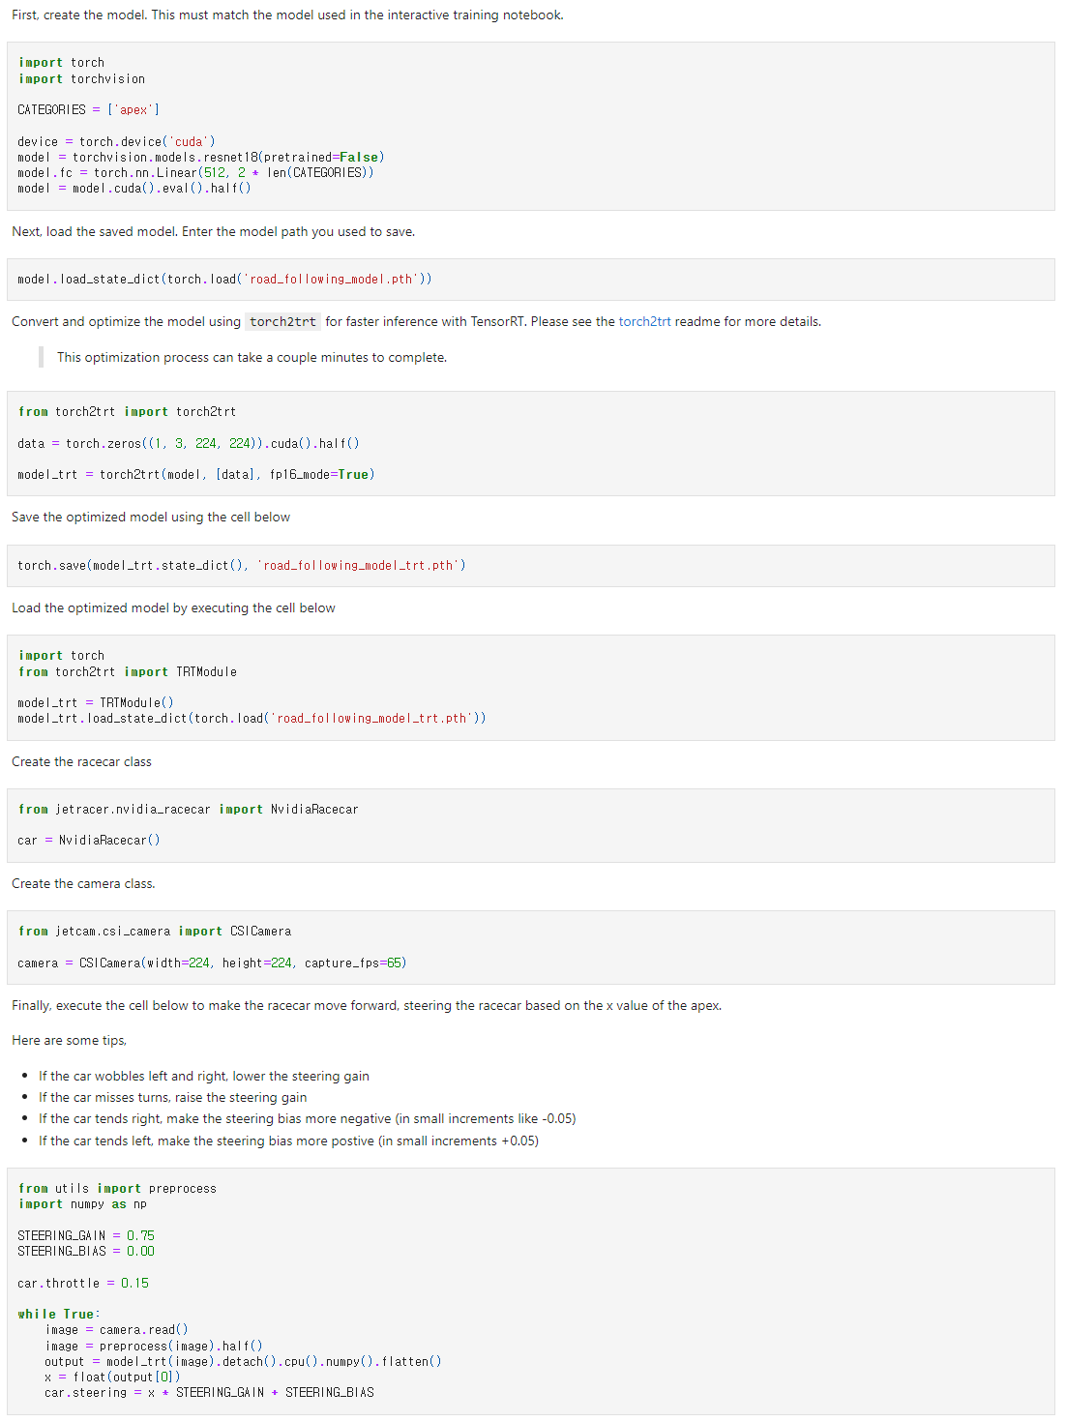
Overview of road_following.ipynb
1
Define model
Configure
racecar & camera
2
3
Iterative inference
4
Load pretrained model
Notes:
This is overview of Road_following file.
First define model.
Second, Load pretrained model, and Third, configure racecar and camera.
For last is Iterative inference.
We will discuss it in detail.
4. 모델을 통해 추론한다.

Slide 5
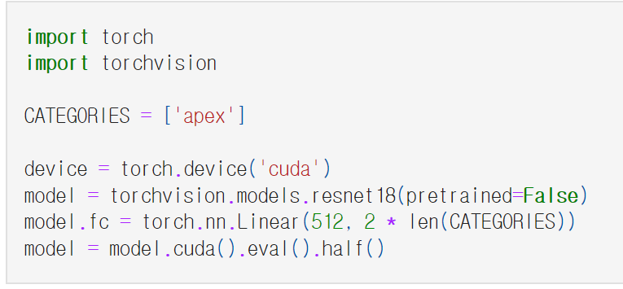
1. Define model
Import modules to define model
‘apex’ directs a point with x, y coordination
in camera image
Declare resnet18 to define model
Set fc layer’s output size as 2 (x, y)
Set data type to float16
Set model’s mode as evaluation
Load model to GPU
Notes:
Tensor.half(memory_format=torch.preserve_format) → Tensorself.half() is equivalent to self.to(torch.float16). See to().
First is define model.
Import modules to define model, and in here categories, ‘apex’ directs a point with x, y coordination in camera image.
Next, we will use resnet18 to define model.
And set fc layer’s output size as 2 (x,y)
For last line, cuda mean load model to GPU, and eval means to set model’s mode as evaluation, and half means to set data type to float16.

Slide 6
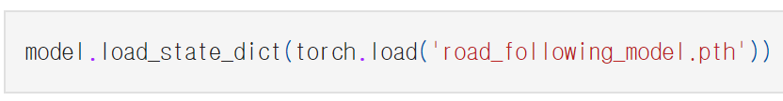


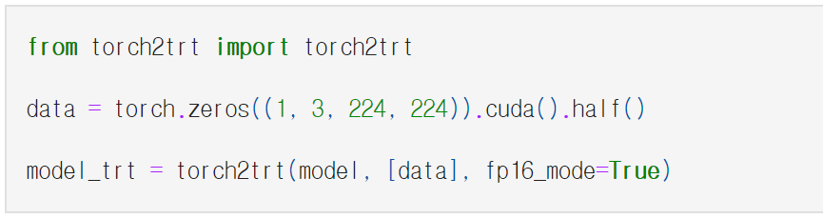
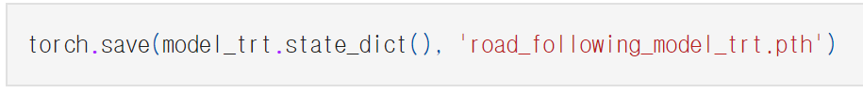
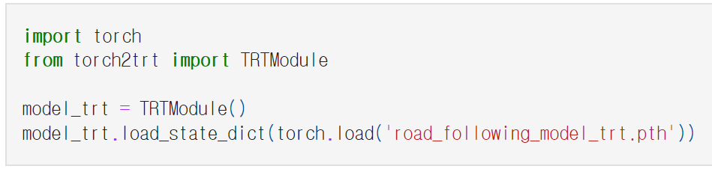
2. Load pretrained model
Load pretrained model from '~.pth’ file.
model(resnet18)
Import Torch2trt for better performance
Declare sample data with the same size as target data
Convert model from pytorch to TensorRT
Save converted model parameters
Declare trt model which stores the original model
Load saved model parameters
Notes:
https://nvidia-ai-iot.github.io/torch2trt/v0.3.0/usage/basic_usage.html
Second step is Load pretrained model.
Load pretrained model from .pth file. This is uploaded at LMS.
Then import torch2trt for better performance. Declare sample data with the same size as target data
Convert model from pytorch to TensorRT
Save converted model parameters
Declare trt model which stores the original model
Load saved model parameters

Slide 7
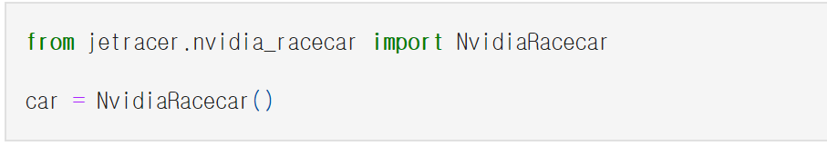
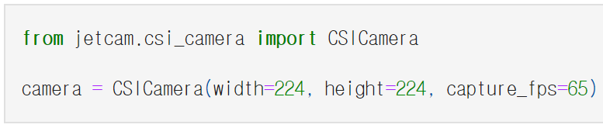
3. Configure race car and camera
Create race car class
Create camera class
Notes:
Third step is configure race car and camera
First create race car class, and create camera class

Slide 8
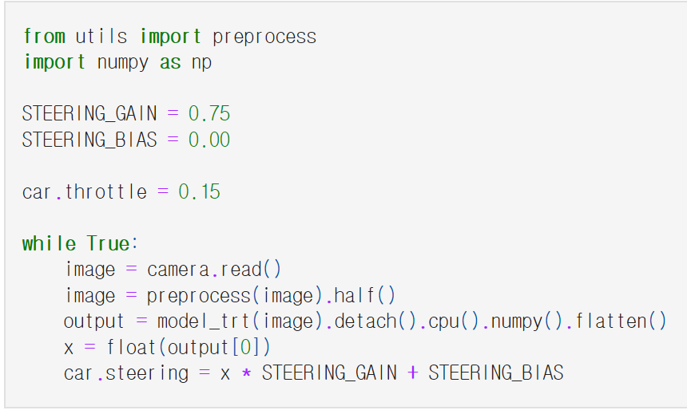
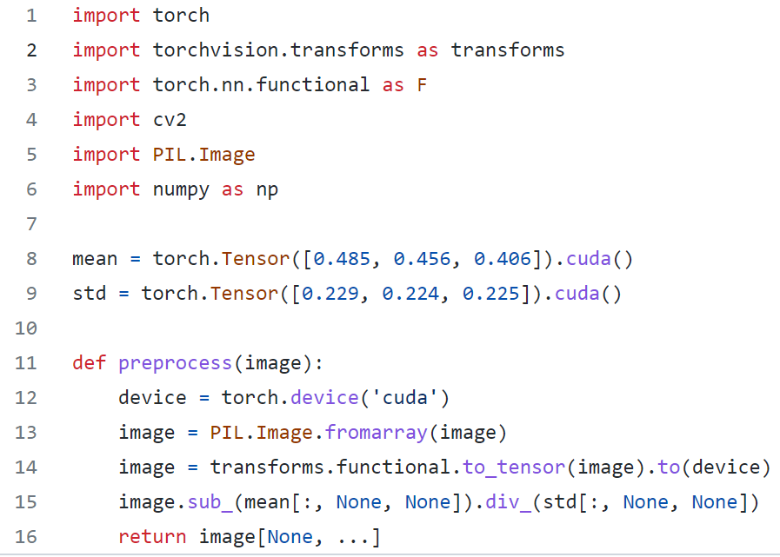
4. Iterative inference
Set fixed multiplier and adder for steering
Set throttle to fixed value
Read real-time image from camera
Feed image values and get the output from the model
From output, car inferences steering value
Return normalized image values
Notes:
Last is about Iterative inference
First, Set fixed multiplier and adder for steering
Set throttle to fixed value
Read real-time image from camera
Then this preprocess function Return normalized image values as shown below.
Feed image values and get the output from the model
From output, car inferences steering value

Slide 9
Experiments :
Upload pretrained model.
Q.1.1. Download trained model “road_following_model_gwsur.pth“ from LMS.
Q.1.2. Visit to localhost:8888/lab/tree/jetracer/notebooks/road_following.ipynb
Q.1.3. Upload the model pth file and write the models name on code model.load_state_dict(torch.load('road_following_model_gwsur.pth'))
Observe and execute the model.
Q.2.1. Unfold the track in suitable place. And put the car on the track.
Q.2.2. Run codes along with the cell.
Q.2.3(optional). Reference and use “teleoperation.ipynb” code to prevent missing car.
Q.2.4. Observe the car’s trace. Are the steering and throttle are suitable?
Q.2.5. Control the value of throttle (slower or faster).
Notes:
From now on, Try these experiments.
First you should download model from LMS.
This model in the LMS is relatively less trained than the model in the video.
At next lecture, you will train this model to perform well.
Today purpose is to execute the model.
Let’s go downstairs and do it yourself

Slide 10
Experiments :
Make variable environments and execute the model.
Q.3.1. Place the car in opposite direction of Q2 and execute model.
Is the model following the road similar?
Q.3.2. Place a small obstacle on the road. How’s the car doing?

